Slide 1
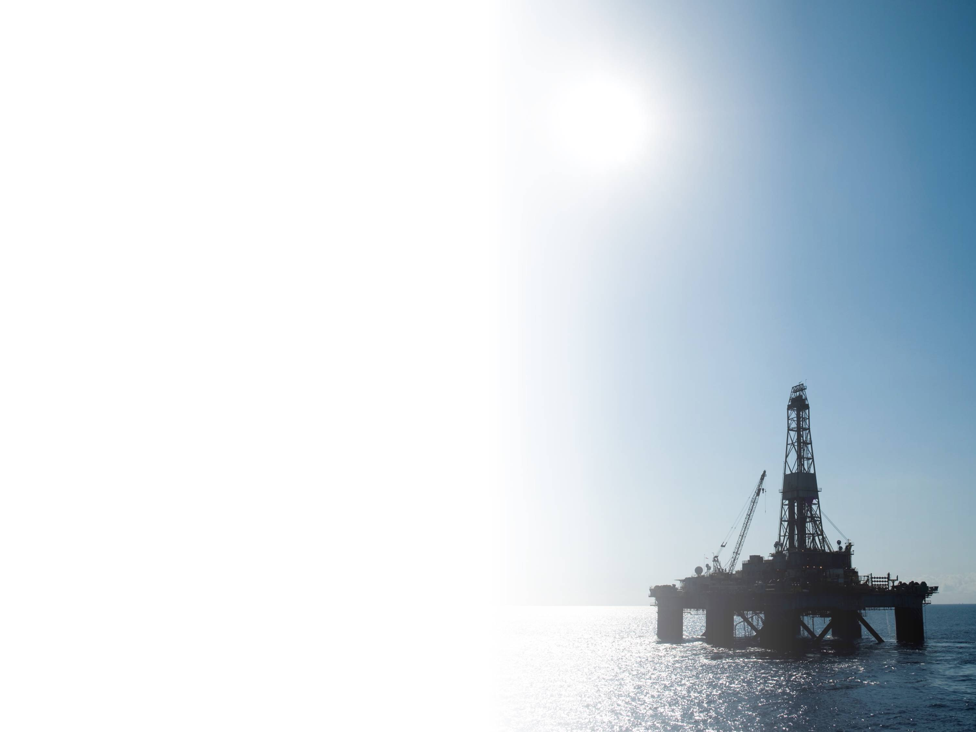


Kinetics of Precipitation and Aggregation of PC003/PC004
Mohammed I. L. Abutaqiya, Ph.D.
ENNOVA LLC
 lab@ennova.us  +1 (832) 835-1557
November 2021

Slide 2
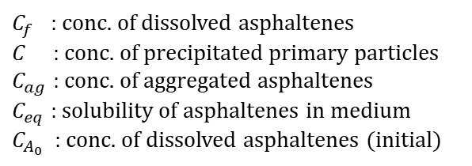
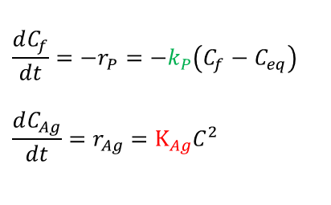
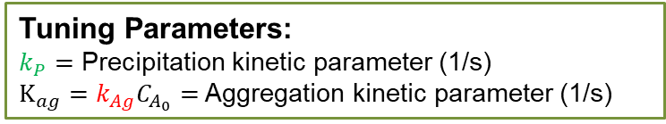



Asphaltene Kinetics
Aggregation test: tuning precipitation ($k_{P}$) and aggregation ($k_{Ag}$) rates
$$\frac{dC_{f}}{dt}=−r_{P}=−k_{P}\left(C_{f}−C_{eq}\right)$$
$$\frac{dC_{Ag}}{dt}=r_{Ag}=K_{Ag}C^{2}$$
Precipitation Kinetics $→$
Aggregation Kinetics $→$
time evolution of primary particles
primary particles depleted by aggregation
$$\frac{dC}{dt}=r_{P}−r_{Ag}=k_{P}\left(C_{f}−C_{eq}\right)−K_{Ag}C^{2}$$
$C_{f}$ : conc. of dissolved asphaltenes
$C$ : conc. of precipitated primary particles
$C_{ag}$ : conc. of aggregated asphaltenes
$C_{eq}$ : solubility of asphaltenes in medium
$C_{A_{0}}$ : conc. of dissolved asphaltenes (initial)
primary particles formed by precipitation
Tuning Parameters:
$k_{P}=$ Precipitation kinetic parameter (1/s)
$K_{ag}=k_{Ag}C_{A_{0}}=$ Aggregation kinetic parameter (1/s)
2

Slide 3

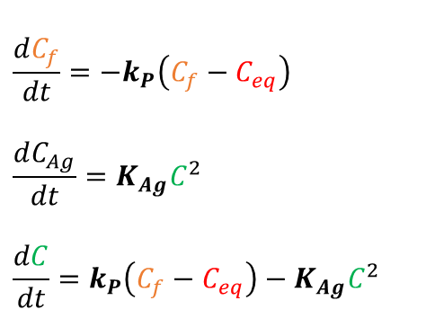



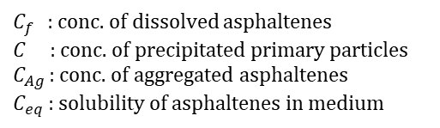

Asphaltene Kinetics
Aggregation test: tuning precipitation ($k_{P}$) and aggregation ($k_{Ag}$) rates
$$\frac{dC_{f}}{dt}=−k_{P}\left(C_{f}−C_{eq}\right)$$
$$\frac{dC_{Ag}}{dt}=K_{Ag}C^{2}$$
$$\frac{dC}{dt}=k_{P}\left(C_{f}−C_{eq}\right)−K_{Ag}C^{2}$$
$C_{f}$ : conc. of dissolved asphaltenes
$C$ : conc. of precipitated primary particles
$C_{Ag}$ : conc. of aggregated asphaltenes
$C_{eq}$ : solubility of asphaltenes in medium
Precipitation: $\ln{k_{P}}\left[\frac{1}{s}\right]=\ln{a_{0}}−\frac{a_{1}}{{10}^{−3}T}$
$$C_{f}$$
$$C$$
Aggregation: $K_{Ag}\left[\frac{1}{s}\right]=k_{Ag}\left[\frac{m^{3}}{kg.s}\right]C_{A_{0}}\left[\frac{kg}{m^{3}}\right]=C_{A_{0}}\frac{1}{750}\left(\frac{2}{3}\right)\frac{RT}{μ}c_{0}$
$$C_{ag}$$
$$C_{eq}=C_{f}\left(t→∞\right)=f\left(T,P,n\right)$$
3

Slide 4
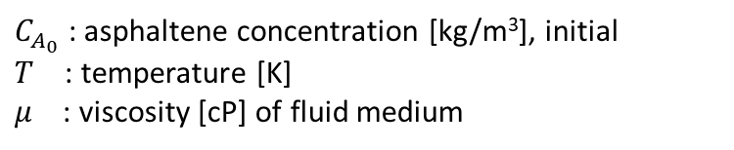

Asphaltene Kinetics
Aggregation test: tuning precipitation ($k_{P}$) and aggregation ($k_{Ag}$) rates
Because the simulations of primary interest involve the live oil at high temperature, it is important that the precipitation and aggregation kinetics measured in the dead oil aggregation test can be extrapolated to the conditions of interest.
Precipitation: $\ln{k_{P}}\left[\frac{1}{s}\right]=\ln{a_{0}}−\frac{a_{1}}{{10}^{−3}T}$
Aggregation: $K_{Ag}\left[\frac{1}{s}\right]=k_{Ag}\left[\frac{m^{3}}{kg.s}\right]C_{A_{0}}\left[\frac{kg}{m^{3}}\right]=C_{A_{0}}\frac{1}{750}\left(\frac{2}{3}\right)\frac{RT}{μ}c_{0}$
$C_{A_{0}}$ : asphaltene concentration [kg/m³], initial
$T$ : temperature [K]
$μ$ : viscosity [cP] of fluid medium
4
Notes:
File: `master_Oxy_562-3.xlsm`
Sheet: `sim_kAg_S2`

Slide 5
Asphaltene Kinetics
Aggregation test: constructing modified oil (MO) + precipitant fluid
A solvent is usually added to the dead oil (STO) to reduce viscosity and/or stabilize asphaltenes. This blend (STO + Solv) is called the modified oil (MO).
A precipitant is then added to the MO to form the MOP blend and the quantification of asphaltene precipitation as a function of time is measured in this fluid.
Modified Oil (MO) = Stock Tank Oil (STO) + Solvent (Solv)
MO
STO
Solv
=
+
* MO composition usually reported as vol% Solv in MO blend
Blend (MOP) = Modified Oil (MO) + Precipitant (Prec)
MOP
MO
Prec
=
+
* MOP composition usually reported as vol% Prec in MOP blend
5

Slide 6
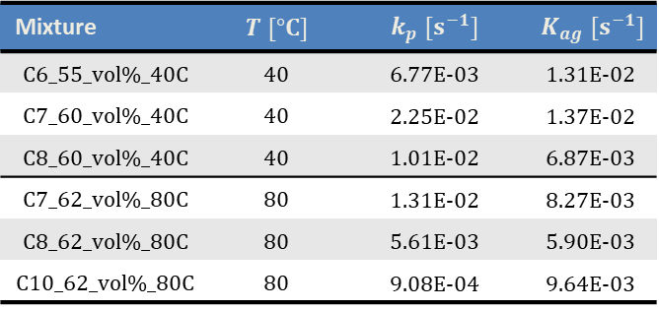
PC003 Kinetic Modeling
PC003 at 40 °C
PC003 at 80 °C
k_{p}/k_{ag} tuned with regularization
Mixture | $$T [°C]$$ | $$k_{p} [s^{−1}]$$ | $$K_{ag} [s^{−1}]$$
C6_55_vol%_40C | 40 | 6.77E-03 | 1.31E-02
C7_60_vol%_40C | 40 | 2.25E-02 | 1.37E-02
C8_60_vol%_40C | 40 | 1.01E-02 | 6.87E-03
C7_62_vol%_80C | 80 | 1.31E-02 | 8.27E-03
C8_62_vol%_80C | 80 | 5.61E-03 | 5.90E-03
C10_62_vol%_80C | 80 | 9.08E-04 | 9.64E-03
*all lab tests are conducted on PC003 with 5 wt% DCB
6

Slide 7
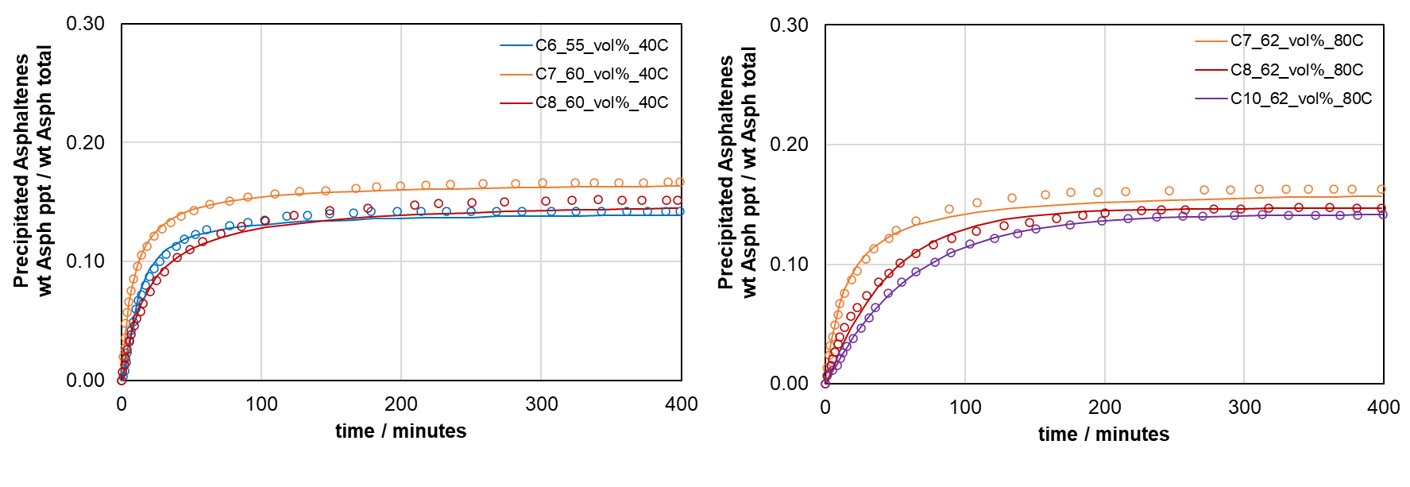
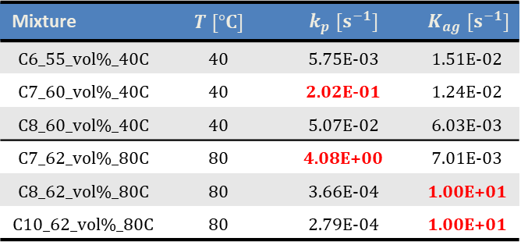
PC003 Kinetic Modeling
PC003 at 40 °C
PC003 at 80 °C
C_{ag} is detected (k_{p}/k_{ag} tuned)
Mixture | $$T [°C]$$ | $$k_{p} [s^{−1}]$$ | $$K_{ag} [s^{−1}]$$
C6_55_vol%_40C | 40 | 5.75E-03 | 1.51E-02
C7_60_vol%_40C | 40 | 2.02E-01 | 1.24E-02
C8_60_vol%_40C | 40 | 5.07E-02 | 6.03E-03
C7_62_vol%_80C | 80 | 4.08E+00 | 7.01E-03
C8_62_vol%_80C | 80 | 3.66E-04 | 1.00E+01
C10_62_vol%_80C | 80 | 2.79E-04 | 1.00E+01
*all lab tests are conducted on PC003 with 5 wt% DCB
7

Slide 8
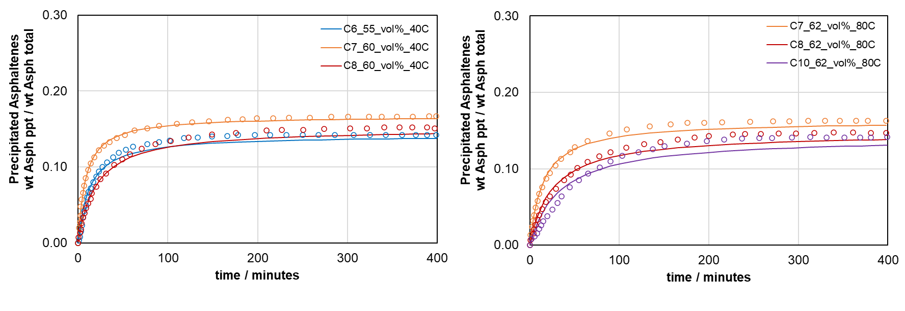
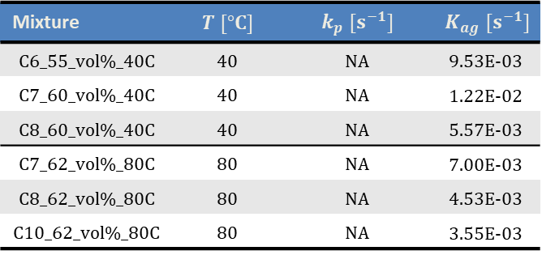
PC003 Kinetic Modeling
PC003 at 40 °C
PC003 at 80 °C
C_{ag} is detected & precip. is instantaneous (k_{p} = inf)
Mixture | $$T [°C]$$ | $$k_{p} [s^{−1}]$$ | $$K_{ag} [s^{−1}]$$
C6_55_vol%_40C | 40 | NA | 9.53E-03
C7_60_vol%_40C | 40 | NA | 1.22E-02
C8_60_vol%_40C | 40 | NA | 5.57E-03
C7_62_vol%_80C | 80 | NA | 7.00E-03
C8_62_vol%_80C | 80 | NA | 4.53E-03
C10_62_vol%_80C | 80 | NA | 3.55E-03
*all lab tests are conducted on PC003 with 5 wt% DCB
8

Slide 9
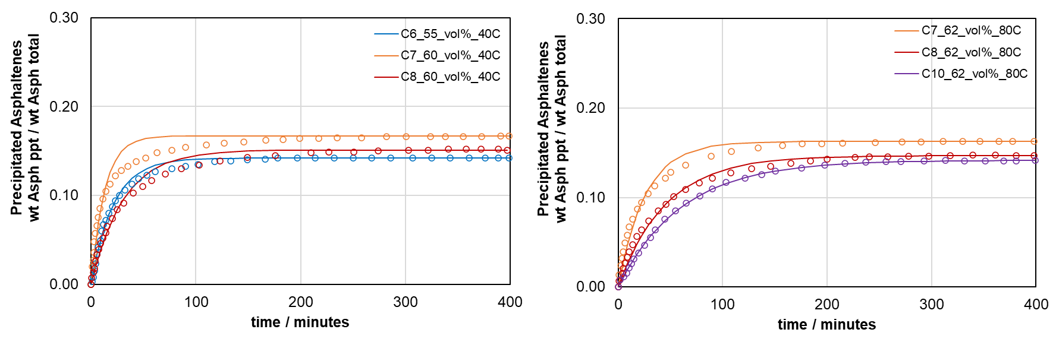
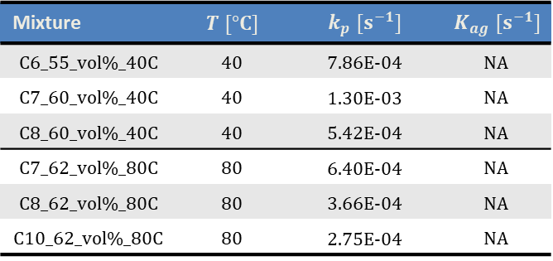
PC003 Kinetic Modeling
PC003 at 40 °C
PC003 at 80 °C
C_{ag} + C is detected (k_{ag} = inf)
Mixture | $$T [°C]$$ | $$k_{p} [s^{−1}]$$ | $$K_{ag} [s^{−1}]$$
C6_55_vol%_40C | 40 | 7.86E-04 | NA
C7_60_vol%_40C | 40 | 1.30E-03 | NA
C8_60_vol%_40C | 40 | 5.42E-04 | NA
C7_62_vol%_80C | 80 | 6.40E-04 | NA
C8_62_vol%_80C | 80 | 3.66E-04 | NA
C10_62_vol%_80C | 80 | 2.75E-04 | NA
*all lab tests are conducted on PC003 with 5 wt% DCB
9

Slide 10
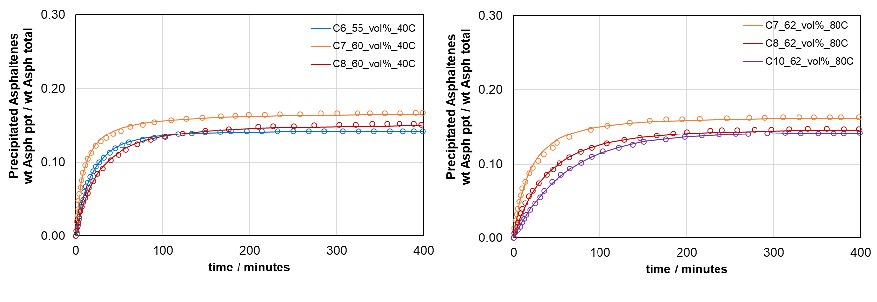
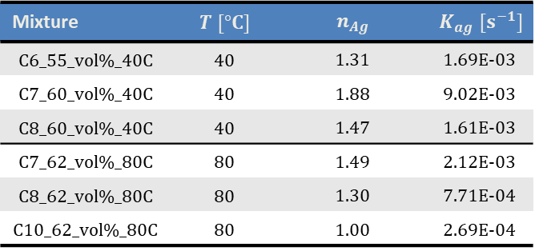
PC003 Kinetic Modeling
PC003 at 40 °C
PC003 at 80 °C
C_{ag} is detected & precip. is instantaneous (k_{p} = inf), n_{Ag} is tuned.
Mixture | $$T [°C]$$ | $$n_{Ag}$$ | $$K_{ag} [s^{−1}]$$
C6_55_vol%_40C | 40 | 1.31 | 1.69E-03
C7_60_vol%_40C | 40 | 1.88 | 9.02E-03
C8_60_vol%_40C | 40 | 1.47 | 1.61E-03
C7_62_vol%_80C | 80 | 1.49 | 2.12E-03
C8_62_vol%_80C | 80 | 1.30 | 7.71E-04
C10_62_vol%_80C | 80 | 1.00 | 2.69E-04
*all lab tests are conducted on PC003 with 5 wt% DCB
10

Slide 11
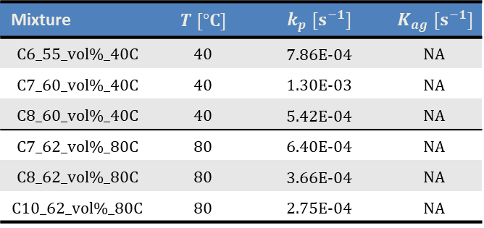
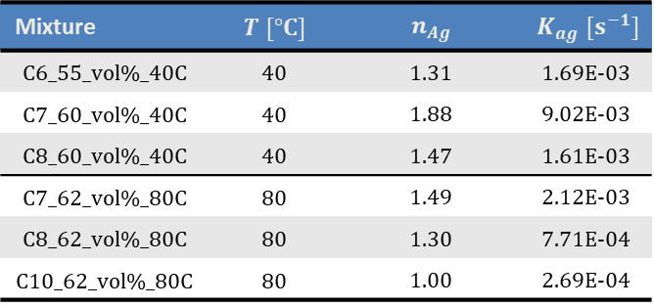
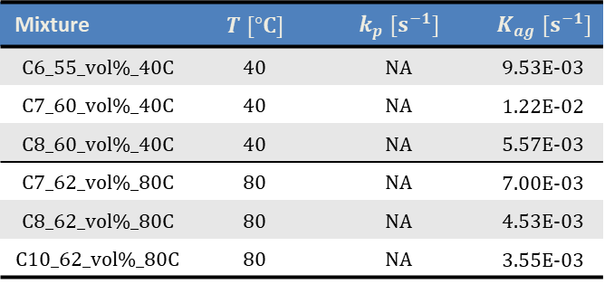
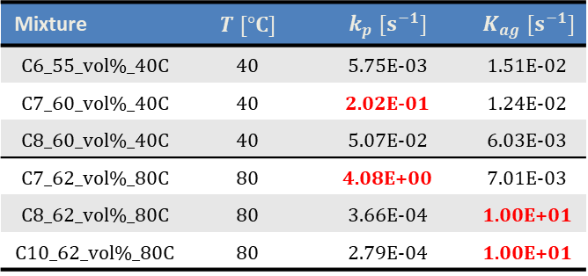
PC003 Kinetic Modeling - Summary
C_{ag} is detected (k_{p}/k_{ag} tuned)
C_{ag} + C is detected (k_{ag} = inf)
Mixture | $$T [°C]$$ | $$k_{p} [s^{−1}]$$ | $$K_{ag} [s^{−1}]$$
C6_55_vol%_40C | 40 | 5.75E-03 | 1.51E-02
C7_60_vol%_40C | 40 | 2.02E-01 | 1.24E-02
C8_60_vol%_40C | 40 | 5.07E-02 | 6.03E-03
C7_62_vol%_80C | 80 | 4.08E+00 | 7.01E-03
C8_62_vol%_80C | 80 | 3.66E-04 | 1.00E+01
C10_62_vol%_80C | 80 | 2.79E-04 | 1.00E+01
Mixture | $$T [°C]$$ | $$k_{p} [s^{−1}]$$ | $$K_{ag} [s^{−1}]$$
C6_55_vol%_40C | 40 | 7.86E-04 | NA
C7_60_vol%_40C | 40 | 1.30E-03 | NA
C8_60_vol%_40C | 40 | 5.42E-04 | NA
C7_62_vol%_80C | 80 | 6.40E-04 | NA
C8_62_vol%_80C | 80 | 3.66E-04 | NA
C10_62_vol%_80C | 80 | 2.75E-04 | NA
C_{ag} is detected & precip. is instantaneous (k_{p} = inf)
C_{ag} is detected & precip. is instantaneous (k_{p} = inf), n_{Ag} is tuned.
Mixture | $$T [°C]$$ | $$k_{p} [s^{−1}]$$ | $$K_{ag} [s^{−1}]$$
C6_55_vol%_40C | 40 | NA | 9.53E-03
C7_60_vol%_40C | 40 | NA | 1.22E-02
C8_60_vol%_40C | 40 | NA | 5.57E-03
C7_62_vol%_80C | 80 | NA | 7.00E-03
C8_62_vol%_80C | 80 | NA | 4.53E-03
C10_62_vol%_80C | 80 | NA | 3.55E-03
Mixture | $$T [°C]$$ | $$n_{Ag}$$ | $$K_{ag} [s^{−1}]$$
C6_55_vol%_40C | 40 | 1.31 | 1.69E-03
C7_60_vol%_40C | 40 | 1.88 | 9.02E-03
C8_60_vol%_40C | 40 | 1.47 | 1.61E-03
C7_62_vol%_80C | 80 | 1.49 | 2.12E-03
C8_62_vol%_80C | 80 | 1.30 | 7.71E-04
C10_62_vol%_80C | 80 | 1.00 | 2.69E-04
11

Slide 12
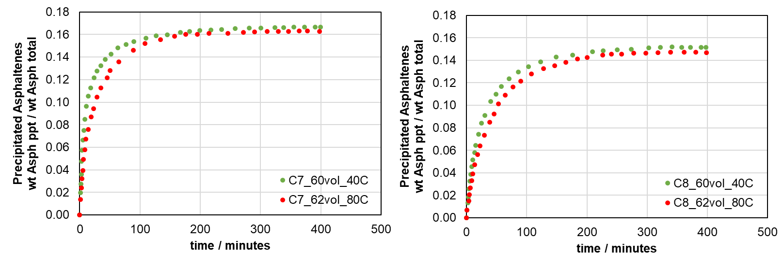
PC003 Kinetic Modeling - Summary
nC7
nC8
12

Slide 13
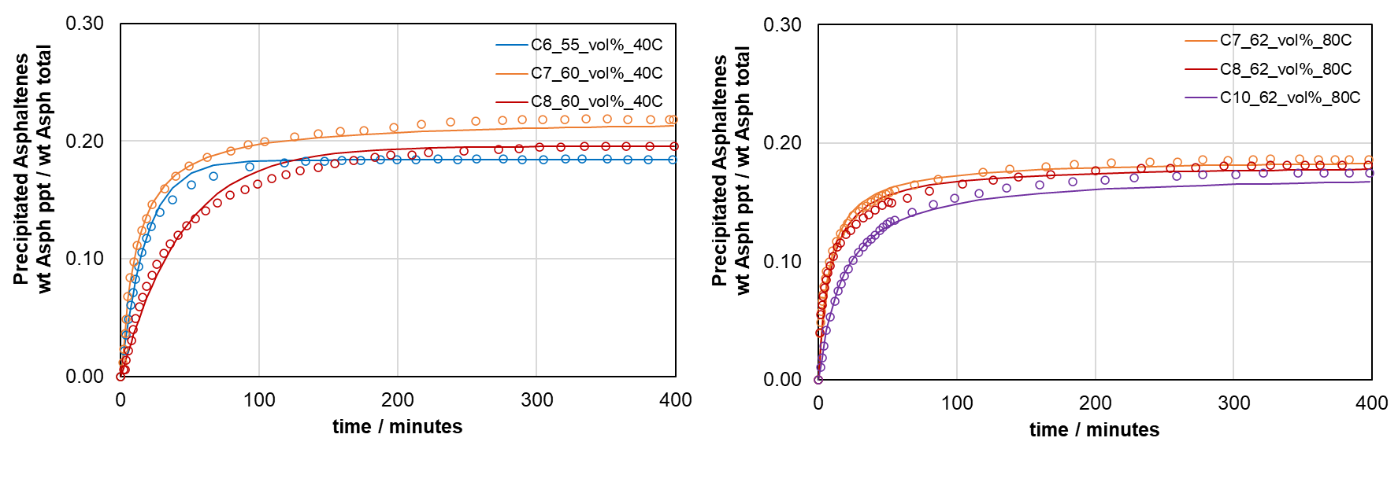
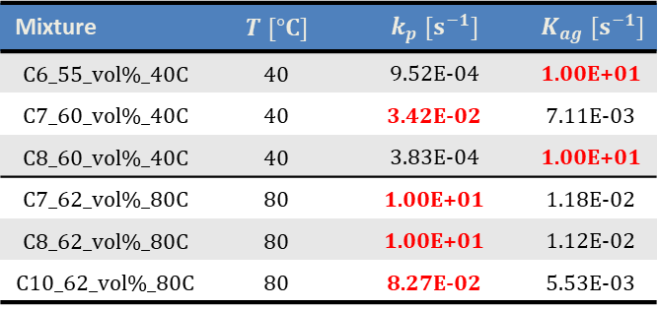
PC004 Kinetic Modeling
PC004 at 40 °C
PC004 at 80 °C
C_{ag} is detected (k_{p}/k_{ag} tuned)
Mixture | $$T [°C]$$ | $$k_{p} [s^{−1}]$$ | $$K_{ag} [s^{−1}]$$
C6_55_vol%_40C | 40 | 9.52E-04 | 1.00E+01
C7_60_vol%_40C | 40 | 3.42E-02 | 7.11E-03
C8_60_vol%_40C | 40 | 3.83E-04 | 1.00E+01
C7_62_vol%_80C | 80 | 1.00E+01 | 1.18E-02
C8_62_vol%_80C | 80 | 1.00E+01 | 1.12E-02
C10_62_vol%_80C | 80 | 8.27E-02 | 5.53E-03
*all lab tests are conducted on PC004 with 5 wt% DCB
13

Slide 14
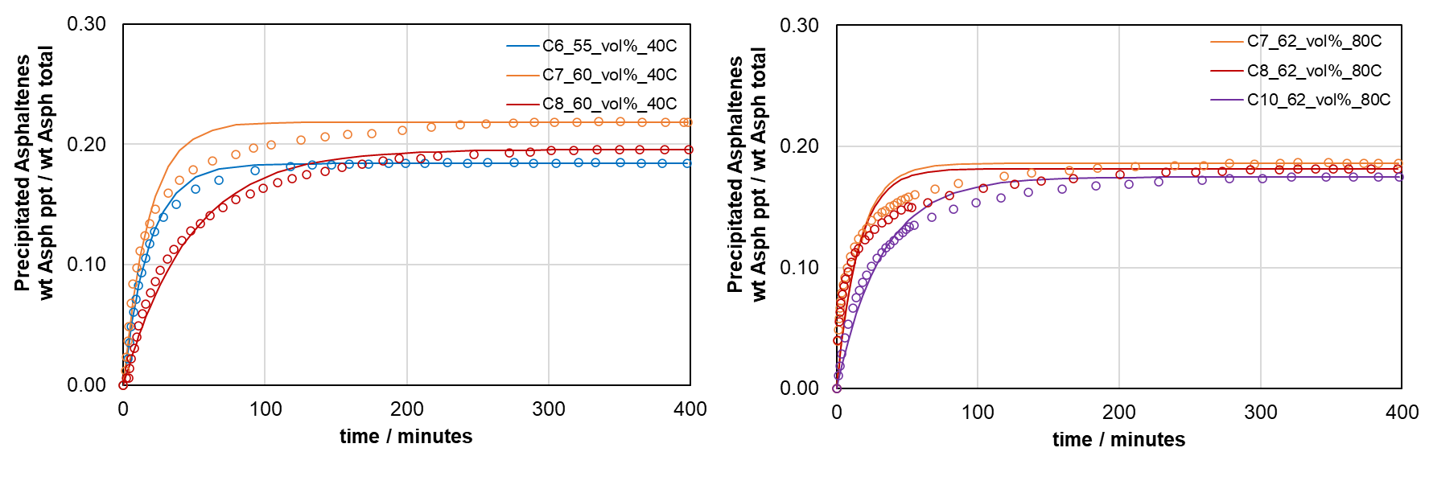
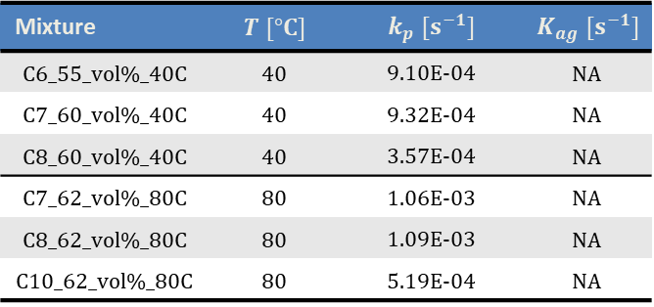
PC004 Kinetic Modeling
PC004 at 40 °C
PC004 at 80 °C
C_{ag} + C is detected (k_{ag} = inf)
Mixture | $$T [°C]$$ | $$k_{p} [s^{−1}]$$ | $$K_{ag} [s^{−1}]$$
C6_55_vol%_40C | 40 | 9.10E-04 | NA
C7_60_vol%_40C | 40 | 9.32E-04 | NA
C8_60_vol%_40C | 40 | 3.57E-04 | NA
C7_62_vol%_80C | 80 | 1.06E-03 | NA
C8_62_vol%_80C | 80 | 1.09E-03 | NA
C10_62_vol%_80C | 80 | 5.19E-04 | NA
*all lab tests are conducted on PC004 with 5 wt% DCB
14

Slide 15
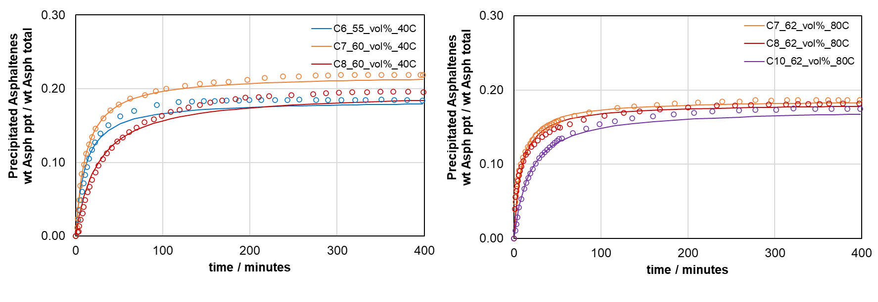
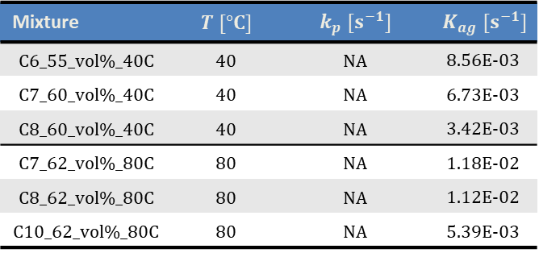
PC004 Kinetic Modeling
PC004 at 40 °C
PC004 at 80 °C
C_{ag} is detected & precip. is instantaneous (k_{p} = inf)
Mixture | $$T [°C]$$ | $$k_{p} [s^{−1}]$$ | $$K_{ag} [s^{−1}]$$
C6_55_vol%_40C | 40 | NA | 8.56E-03
C7_60_vol%_40C | 40 | NA | 6.73E-03
C8_60_vol%_40C | 40 | NA | 3.42E-03
C7_62_vol%_80C | 80 | NA | 1.18E-02
C8_62_vol%_80C | 80 | NA | 1.12E-02
C10_62_vol%_80C | 80 | NA | 5.39E-03
*all lab tests are conducted on PC004 with 5 wt% DCB
15

Slide 16
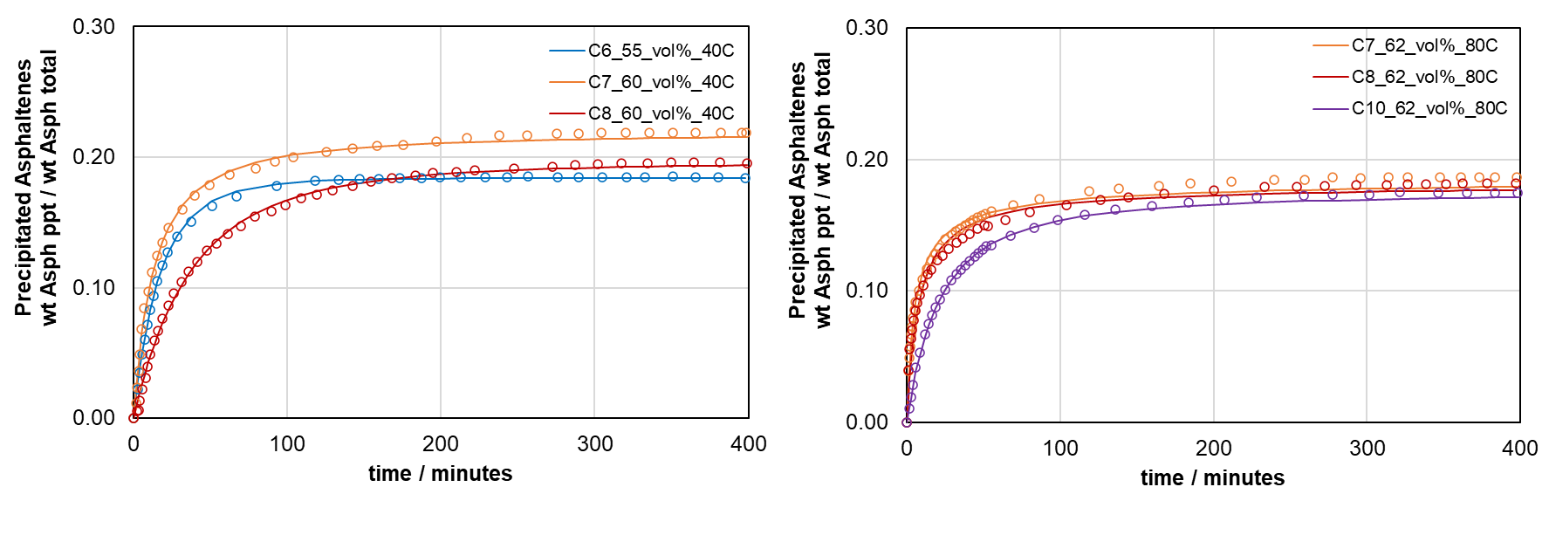
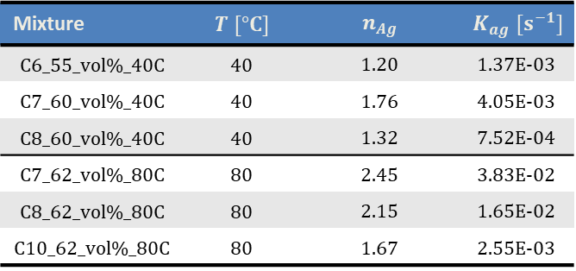
PC004 Kinetic Modeling
PC004 at 40 °C
PC004 at 80 °C
C_{ag} is detected & precip. is instantaneous (k_{p} = inf), n_{Ag} is tuned.
Mixture | $$T [°C]$$ | $$n_{Ag}$$ | $$K_{ag} [s^{−1}]$$
C6_55_vol%_40C | 40 | 1.20 | 1.37E-03
C7_60_vol%_40C | 40 | 1.76 | 4.05E-03
C8_60_vol%_40C | 40 | 1.32 | 7.52E-04
C7_62_vol%_80C | 80 | 2.45 | 3.83E-02
C8_62_vol%_80C | 80 | 2.15 | 1.65E-02
C10_62_vol%_80C | 80 | 1.67 | 2.55E-03
*all lab tests are conducted on PC004 with 5 wt% DCB
16

Slide 17

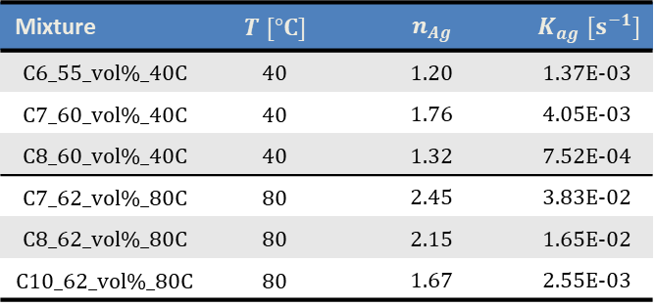
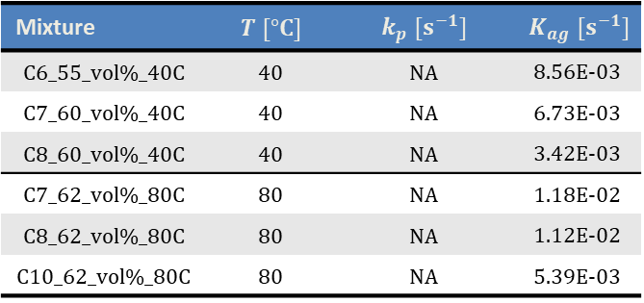
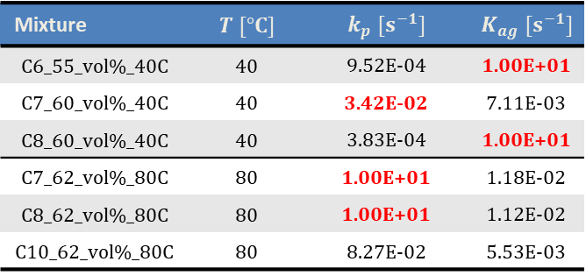
PC004 Kinetic Modeling - Summary
C_{ag} is detected (k_{p}/k_{ag} tuned)
C_{ag} + C is detected (k_{ag} = inf)
Mixture | $$T [°C]$$ | $$k_{p} [s^{−1}]$$ | $$K_{ag} [s^{−1}]$$
C6_55_vol%_40C | 40 | 9.52E-04 | 1.00E+01
C7_60_vol%_40C | 40 | 3.42E-02 | 7.11E-03
C8_60_vol%_40C | 40 | 3.83E-04 | 1.00E+01
C7_62_vol%_80C | 80 | 1.00E+01 | 1.18E-02
C8_62_vol%_80C | 80 | 1.00E+01 | 1.12E-02
C10_62_vol%_80C | 80 | 8.27E-02 | 5.53E-03
Mixture | $$T [°C]$$ | $$k_{p} [s^{−1}]$$ | $$K_{ag} [s^{−1}]$$
C6_55_vol%_40C | 40 | 9.10E-04 | NA
C7_60_vol%_40C | 40 | 9.32E-04 | NA
C8_60_vol%_40C | 40 | 3.57E-04 | NA
C7_62_vol%_80C | 80 | 1.06E-03 | NA
C8_62_vol%_80C | 80 | 1.09E-03 | NA
C10_62_vol%_80C | 80 | 5.19E-04 | NA
C_{ag} is detected & precip. is instantaneous (k_{p} = inf)
C_{ag} is detected & precip. is instantaneous (k_{p} = inf), n_{Ag} is tuned.
Mixture | $$T [°C]$$ | $$k_{p} [s^{−1}]$$ | $$K_{ag} [s^{−1}]$$
C6_55_vol%_40C | 40 | NA | 8.56E-03
C7_60_vol%_40C | 40 | NA | 6.73E-03
C8_60_vol%_40C | 40 | NA | 3.42E-03
C7_62_vol%_80C | 80 | NA | 1.18E-02
C8_62_vol%_80C | 80 | NA | 1.12E-02
C10_62_vol%_80C | 80 | NA | 5.39E-03
Mixture | $$T [°C]$$ | $$n_{Ag}$$ | $$K_{ag} [s^{−1}]$$
C6_55_vol%_40C | 40 | 1.20 | 1.37E-03
C7_60_vol%_40C | 40 | 1.76 | 4.05E-03
C8_60_vol%_40C | 40 | 1.32 | 7.52E-04
C7_62_vol%_80C | 80 | 2.45 | 3.83E-02
C8_62_vol%_80C | 80 | 2.15 | 1.65E-02
C10_62_vol%_80C | 80 | 1.67 | 2.55E-03
17

Slide 18
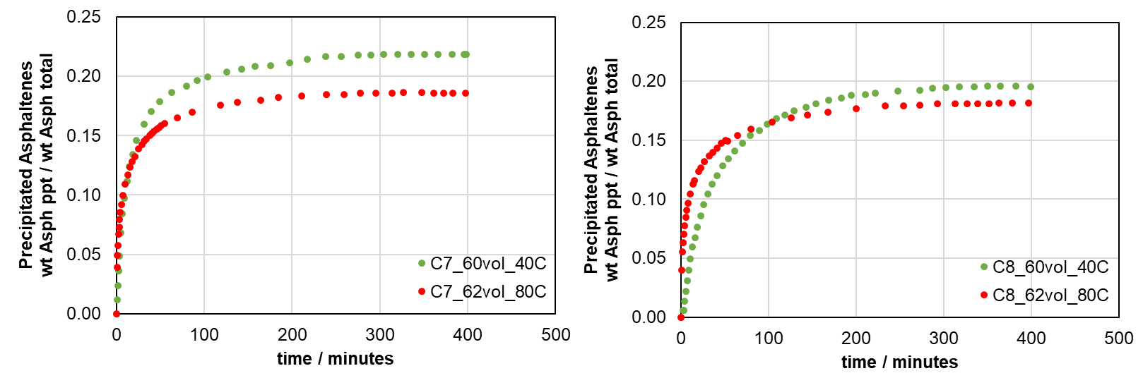
PC004 Kinetic Modeling - Summary
nC7
nC8
18

